Slide 1
What is Diffusion?
Lesson Objectives:
Define the term ‘diffusion’, and describe the passive process.
Describe how dissolved substances can move in and out of a cell, through the cell membrane by diffusion (gradient)
Explain how the rate of diffusion is affected by factors including particle concentration, temperature and surface area
Starter – Think…
When someone sprays their deodorant at the back of the room, apart from making me mad, the smell spreads around the room. Why does it do this?
Review:
Be prepared to share your ideas

Slide 2
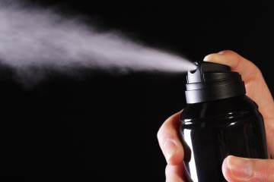

How do these perfume particles make it to the person?

Slide 3
There is a lower concentration of particles here.
There is a high concentration of particles here.
Where will these particles go?
There is a lower concentration of particles here.
There is a lower concentration of particles here.
There is a lower concentration of particles here.

Slide 4
There is a lower concentration of particles here.
There is a high concentration of particles here.
Where will these particles go?
There is a lower concentration of particles here.
They will go to these areas
There is a lower concentration of particles here.
There is a lower concentration of particles here.

Slide 5
There is a lower concentration of particles here.
There is a high concentration of particles here.
This movement is known as diffusion
There is a lower concentration of particles here.
There is a lower concentration of particles here.
There is a lower concentration of particles here.

Slide 6
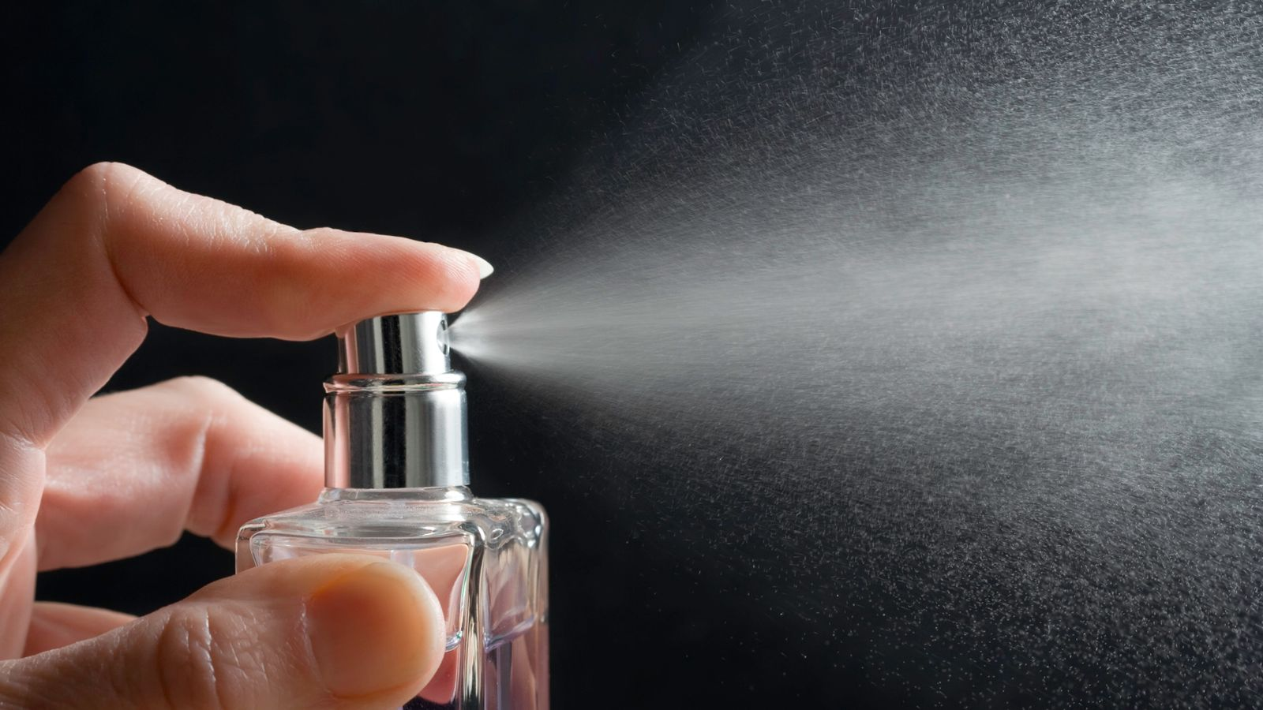
Define the term ‘diffusion’ and describe the passive process.
Diffusion is a passive process which works by particles moving down the concentration gradient, this means no energy is needed for the movement of particles.
High Concentration
No energy!
Low Concentration
Review:
Be prepared to share your ideas

Slide 7
Define the term ‘diffusion’.
Complete this sentence about Diffusion using the words below.
1) Diffusion is the spreading out of __________ from an area of ____________________ to an area of __________________.
particles
lower concentration
high concentration
This difference in concentration is called the concentration gradient.
2) Define the term passive process.
Review:
Be prepared to share your ideas

Slide 8
Define the term ‘diffusion’.
Complete this sentence about Diffusion using the words below.
Diffusion is the spreading out of _particles__ from an area of __high concentration__ to an area of __lower concentration__.
This difference in concentration is called the concentration gradient.
2) A process by which no energy is needed for particles to move, as they move down the concentration gradient.
Review:
Be prepared to share your ideas

Slide 9
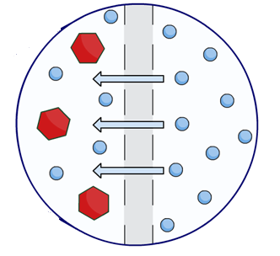
LO: Describe how dissolved substances can move in and out of a cell, through the cell membrane by diffusion (gradient)
The cell membrane surrounding a cell, contains small holes. These holes allow small molecules to pass through, but not large ones. As the membrane only allows certain molecules through we call it a partially-permeable membrane.
Why would these small molecules move across this membrane?
What process must be taking place?
partially- permeable
membrane
Small molecule
Large molecule
Review:
Be prepared to share your ideas

Slide 10
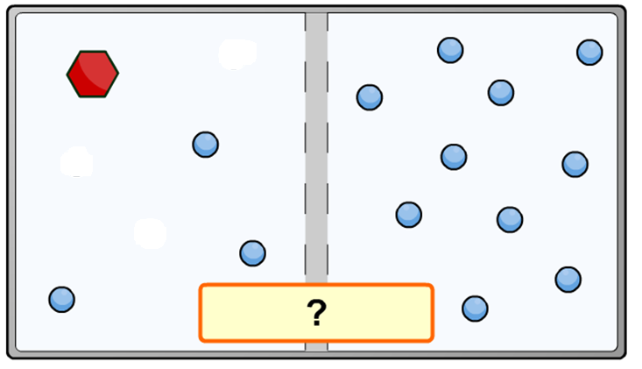
LO: Describe how dissolved substances can move in and out of a cell, through the cell membrane by diffusion (gradient)
Which direction will the small molecules travel? Explain why this will happen. Use key words.
Key words:
Small molecules
Diffusion
High concentration
Low concentration
Partially-permeable membrane
Review:
Be prepared to share your ideas

Slide 11
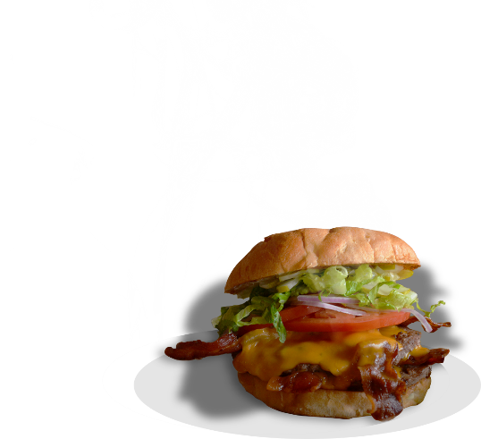
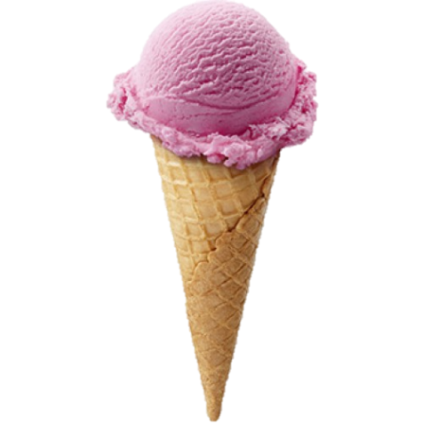
LO: Explain how the rate of diffusion is affected by factors including particle concentration, temperature and surface area
Which particles will diffuse faster?
Why do you think this?
The left side (yellow) is more concentrated than the right (blue). It produces a larger concentration gradient.
Which particles will diffuse faster?
Why do you think this?
The right side (yellow). These burger particles are warmer than the ice cream particles left (blue). The hotter the particle the more (kinetic) energy they have.
Review:
Be prepared to share your ideas

Slide 12
LO: Explain how the rate of diffusion is affected by factors including particle concentration, temperature and surface area
Which particles will diffuse faster?
Why do you think this?
The right side (blue) has a greater surface area. More particles are able to move and diffuse.
Review:
Be prepared to share your ideas

